Slide 1

FOOD CONSUMPTION IN INDIA SANDRINE PREVOT
DAFT NOV21
FEB, 11th | PARIS

Slide 2
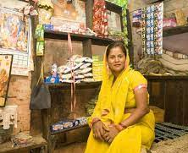
Business case
Domain: Consumer behaviour in India
Analyze the indicators that measure food expenditure for one month, taking into account the link with the social background of household. It allows a better understanding of the consumer, the quality of life and the responsiveness of demand.
Keep in mind: there is a political issue: in a context of Hindu nationalism, the religion and casts is used for political purposes in order to divide Indians (the stigmatization is based food consumption)
The objective of the project is to see whether social characteristics determine consumption behavior or not.

Slide 3
Process
About data
Socio-Economic/Monitoring Survey of NSS
Title: India - Household Consumer Expenditure, NSS 68th Round : July 2011 - June 2012
(Expenditure for 1 month)
From : National Sample Survey Office - Ministry of Statistics and Programme Implementation(MOSPI), Government of India.
Data preparation
EDA
Encode non-numeric data
Clusters Investigation
Model Evaluation
Implementing unsupervised model

Slide 4
Data cleaning and preprocessing
1. Three datasets:
Household: Shape (101662, 45) + Shape (101662, 39)
Food expenditure: Shape (5763152, 35) with 183 food items
2. Build a unique dataset:
Merge on Household ID and features selections: Shape (100497, 33)
7 columns non-numeric – 26 columns numeric (1 ID, 9 on household and 23 on food)
3. Cleaning
Rename labels of columns
Build a new classification with filter on food items
Check for duplicates/ missing value
Exclude outliers in each numeric column
Drop rows with small numbers of household (ex: 'Zoroastrianism’, only one household)
Check collinearity

Slide 5
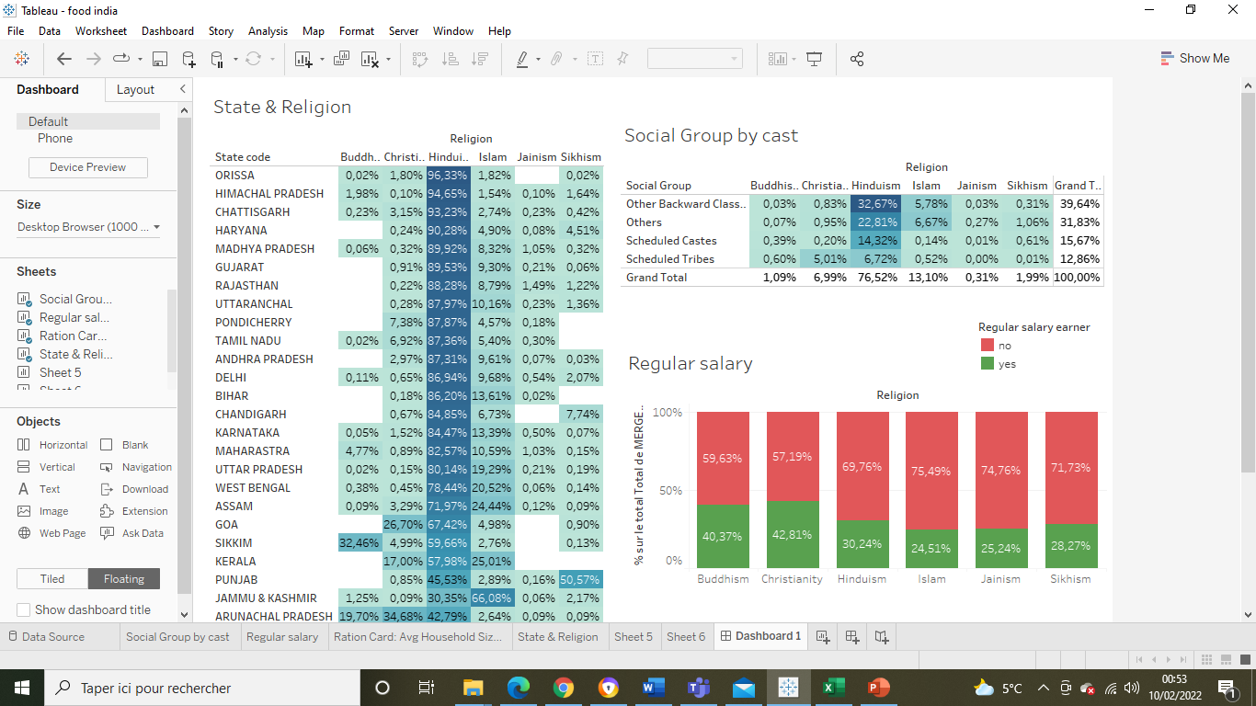
EDA
OBC
Scheduled Castes
Scheduled Tribes
➔ Communities in these administrative divisions benefit from the positive discrimination policy (Quotas in public employment and high School – 50% of places and jobs)
Others:
➔ Communities advanced socially and economically

Slide 6
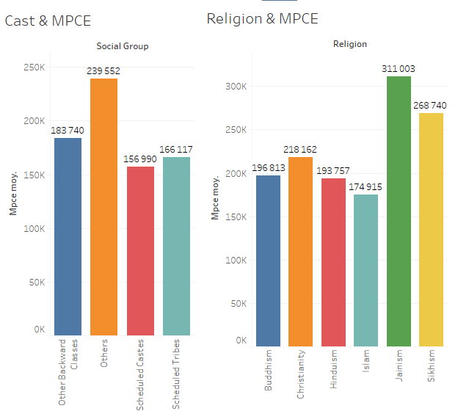
EDA
Monthly Per Capita Consumer Expenditure (MPCE)

Slide 7
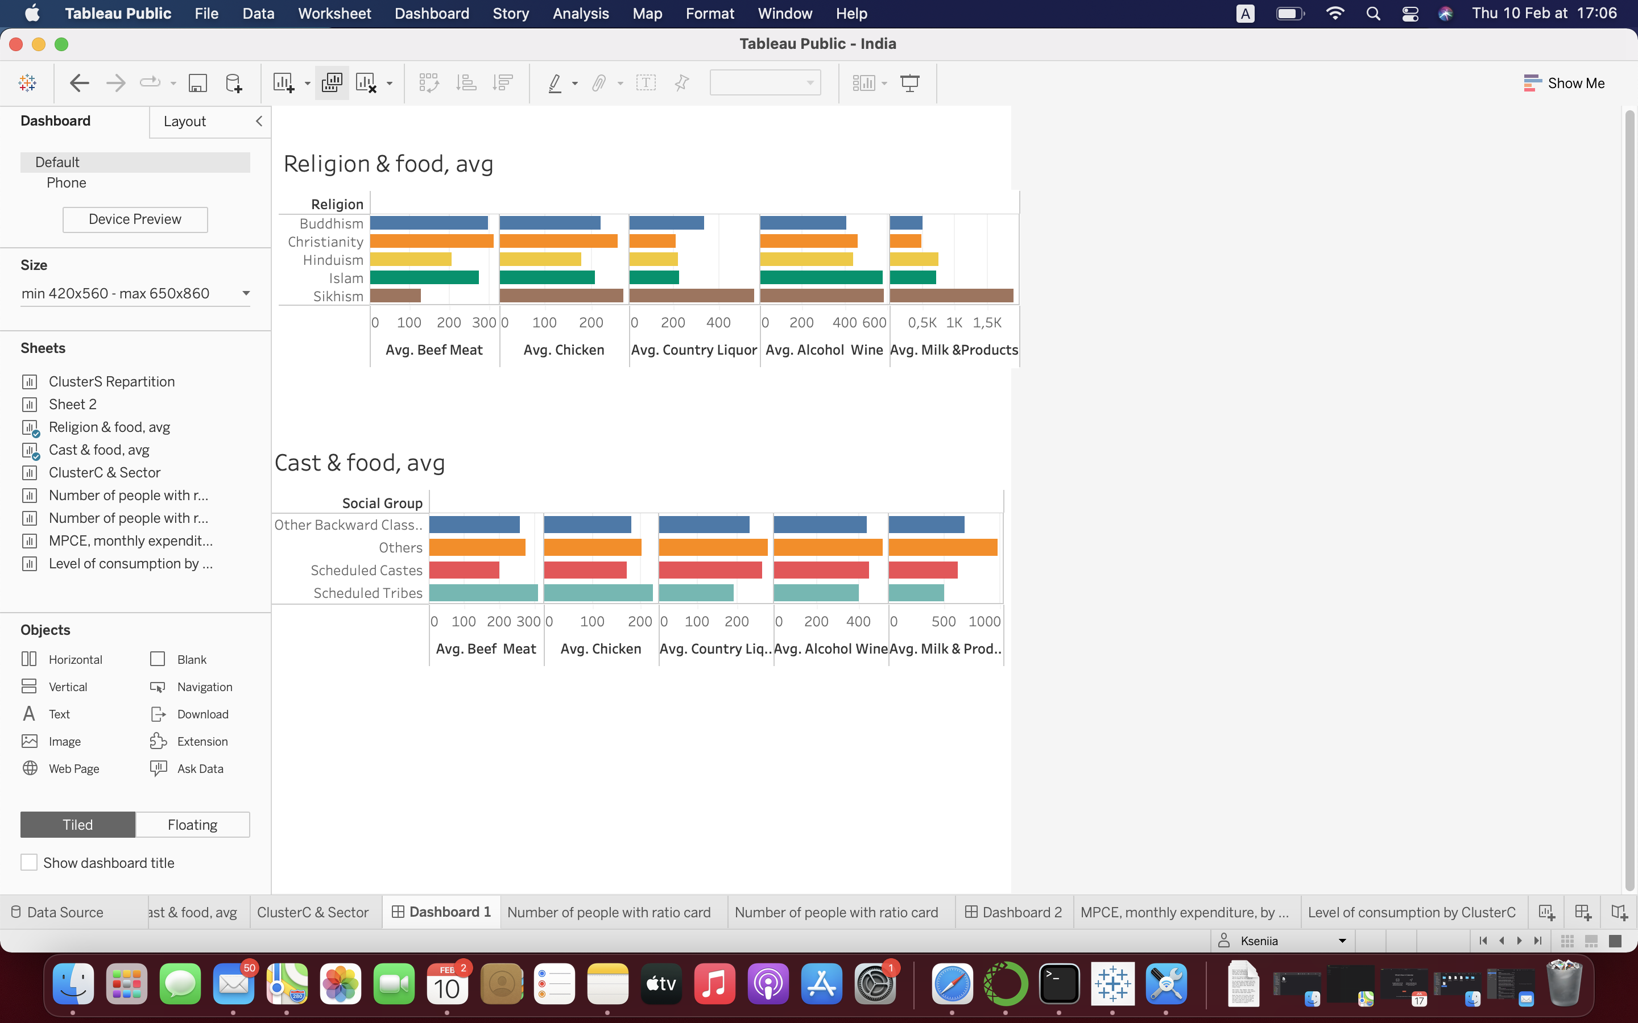
EDA

Slide 8
UNSUPERVIZED MODEL - KMEANS
Unsupervised machine learning algorithm groups similar kinds of items in form of clusters. It finds the similarity between the items and groups them into the clusters.
To group the consumers, I used 24 columns related to food expenses and exclude social background( religion & cast/class) : we will see if the consumer division obtained by algorithm can find that the structure of consumption correspond to social background.
Before to use machine learning algorithms, I applied Principal Component Analysis (PCA). PCA is used for dimensionality reduction in machine learning when there are a lot features/columns/items to analyze. PCA allows also to filter noisy datasets, such as image compression.

Slide 9
RESULTS OF MACHINE LEANING ALGORITHMS
Models | Optimum of clusters | Evaluation with Silhouette Score
KMEANS KElbowVisualizer(k = (2,5), metric='silhouette') | 2 | 0,623
AGGLOMERATIVE MODEL KElbowVisualizer( k = (2,5), metric='silhouette') | 2 | 0,561
GAUSSIAN MIXTURE (range (2,6)) | 2 | 0.620
DBSCAN MODEL (eps in range (1,5)&min_samples in range (2,5)) | 2 ( or 68) | -0.170 ( or -0.939)
➔Algorithms define two group of consumer (cluster0 and cluster1)
Because the silhouette score of Kmeans is better, I choose KMEANS to affect to each household the cluster label.

Slide 10
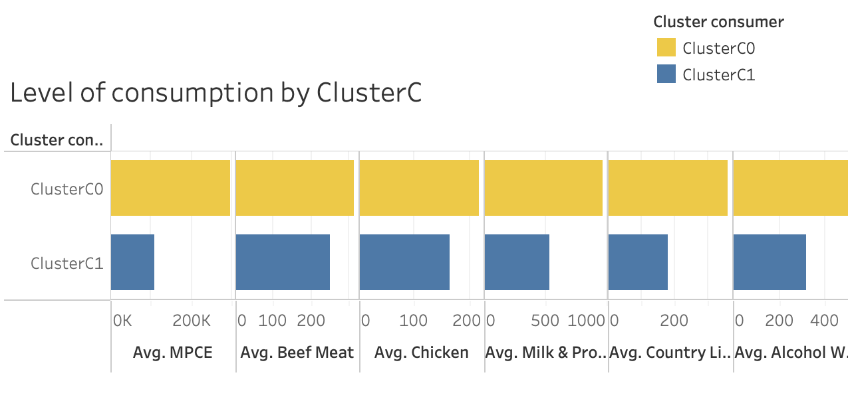
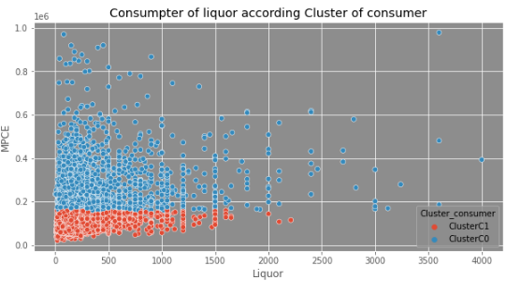
First results : main difference between two group of consumer is related to the revenue/expenses
As we see on the scatter graph concerning the consumption of Alcohol and wine, the division between of the two groups of consuer depends on revenue/expenses,
➔Cluster1, the poorest: In average, they spend less money, eat less food,

Slide 11
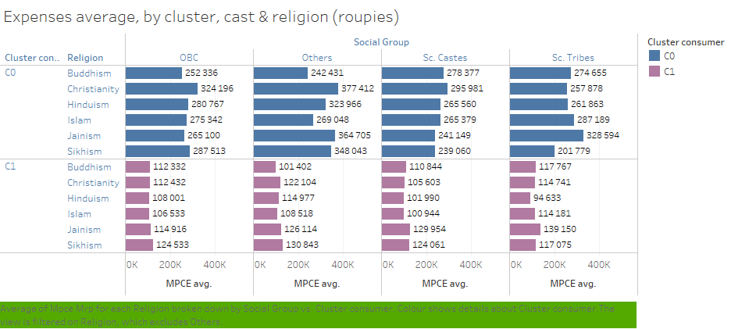
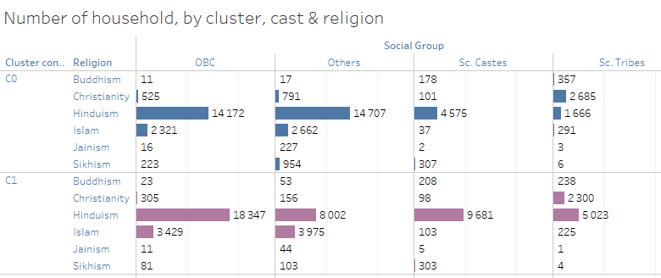
Regarding religion, Sikh, Jain and Christian are the richest, they have the higher monthly expenditure.
Regarding social-background, others is the categories most advantaged.
Hindus are largely majority in all categories, except in the cluster0 where Christian the Sc. Tribes domine Hindu Sc. Tribes

Slide 12
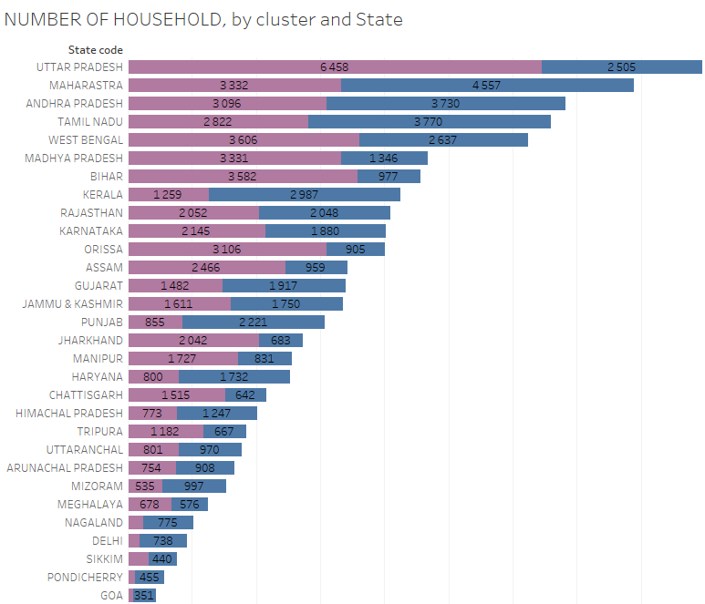
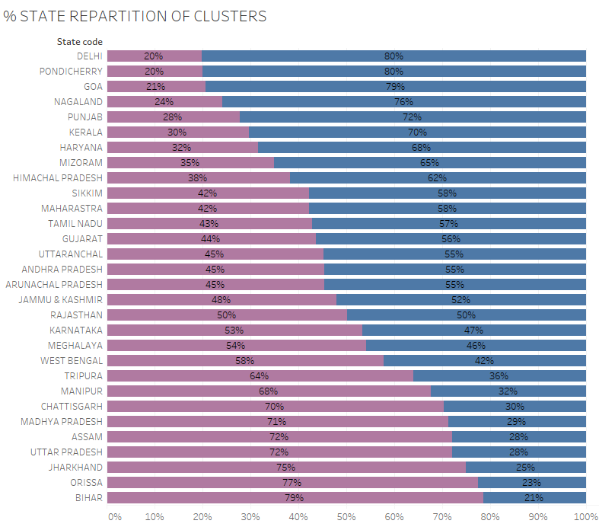
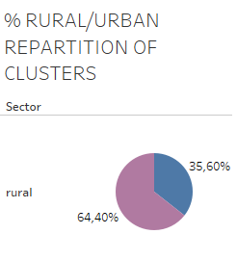
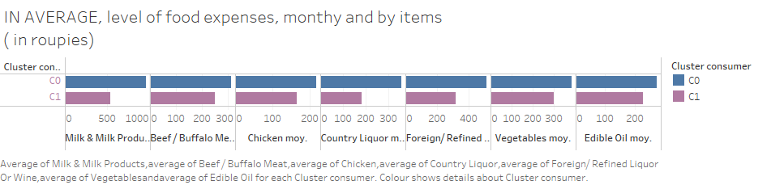
The richer consumers lives in the southern states (Maharashtra, Tamil Nadu, Andhra Pradesh, Kerala) and majority in city.

Slide 13
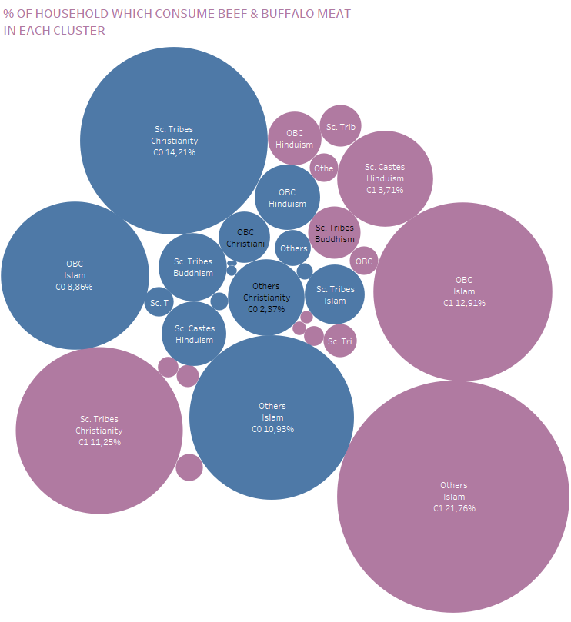
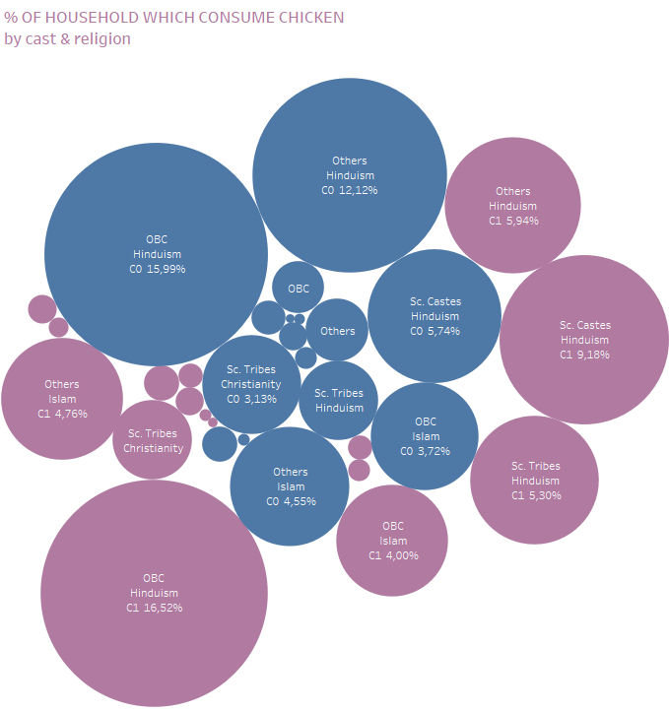
Regarding beef/buffalo meat consumption, Cleary a majority of Sc Tribes Christian in both clusters, and Others and OBC Muslim.
Regarding the consumption of chicken, popular in all categories, especially among Hindus. Consumption goes up in Cluster0, the richer.

Slide 14
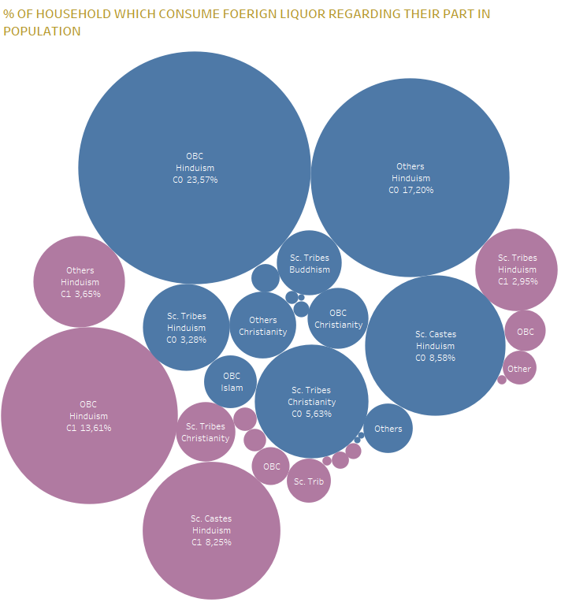
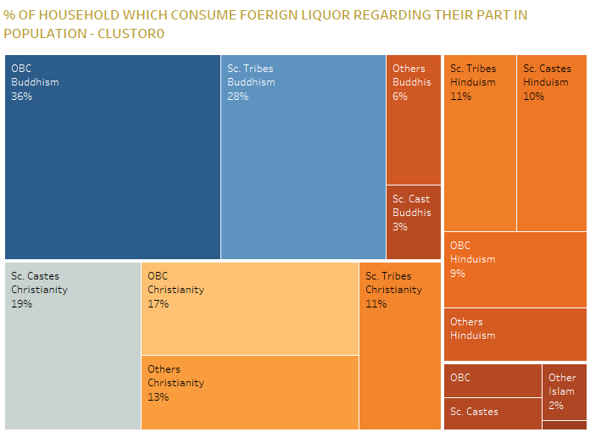
Regarding foreign liquor and wine, concern only 6% of the household. More consumed in cluster0, by Other and OBC Hindu
When we check the part of each categories in the population, Buddhist and Christians consume alcohol than Hindu.

Slide 15
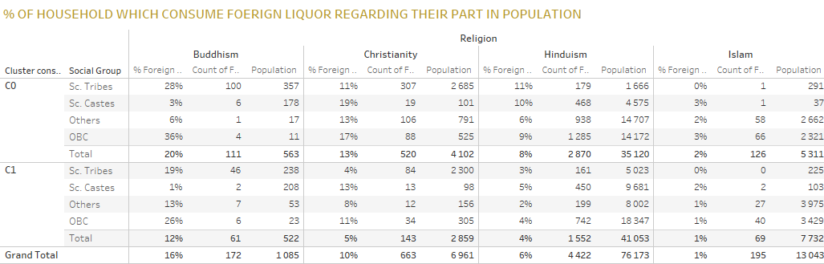

Slide 16
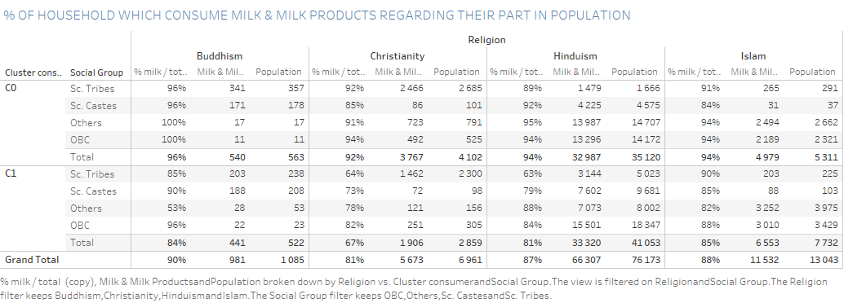

Slide 17
FOOD CONSUMPTION IN INDIA
SANDRINE PREVOT
Q&A?

